Slide 1
Parallax-tolerant Image Stitching
Bhavya Kalra(2018701005)
Shrutimoy Das(2018701011)

Slide 2
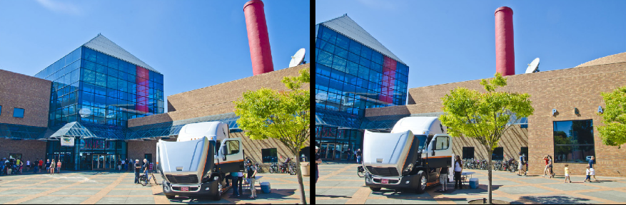
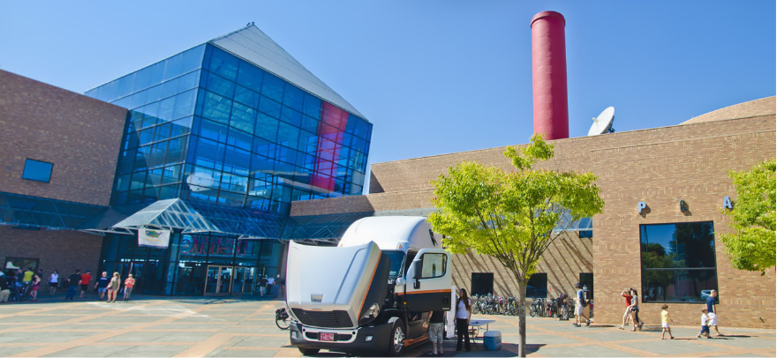
Objective of the Project
Input Images :
Expected Output:

Slide 3
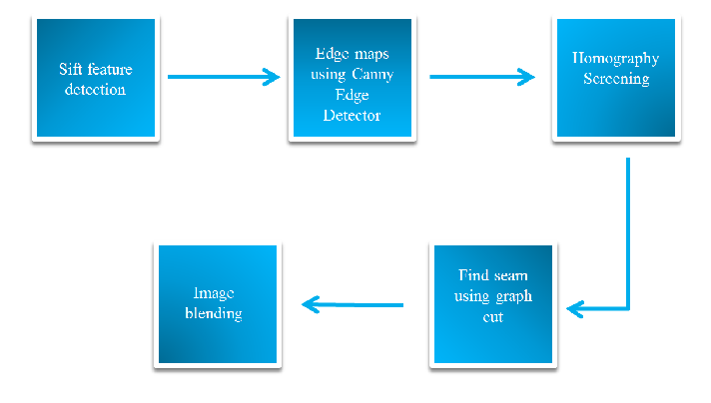
Project Pipeline

Slide 4
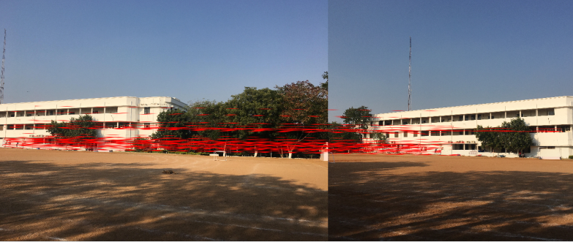
SIFT Feature Matching

Slide 5
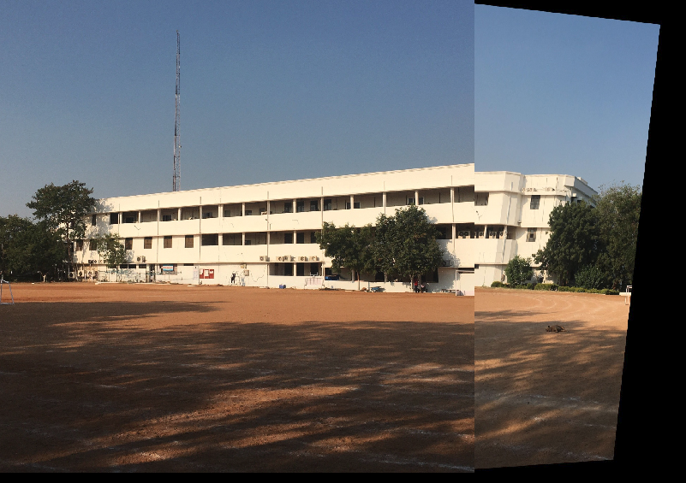
Homography Screening

Slide 6
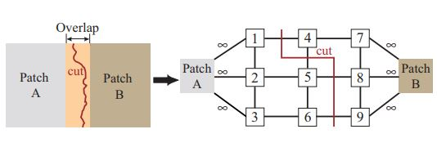
Seam Finding using Graph-Cut Method
Design the seam finding problem as a graph-cut(maxflow) problem
Find the cut that minimizes the cost of the edges
(Image Courtesy : https://www.cc.gatech.edu/~turk/my_papers/graph_cuts.pdf)

Slide 7
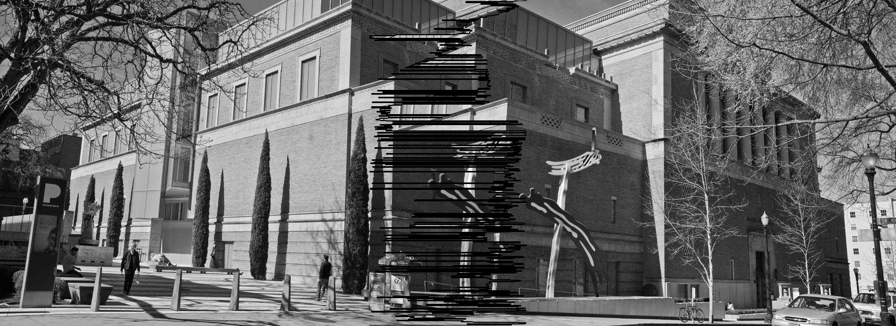
Results using simple cost function
Cost = difference in intensities of neighbouring pixels

Slide 8
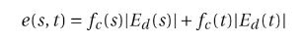
Seam finding using inclusive cost function
Avoid seam through pixels having large values in the edge difference map for seamless stitching.
Use the information of interest points and alignment to define the cost function.

Slide 9
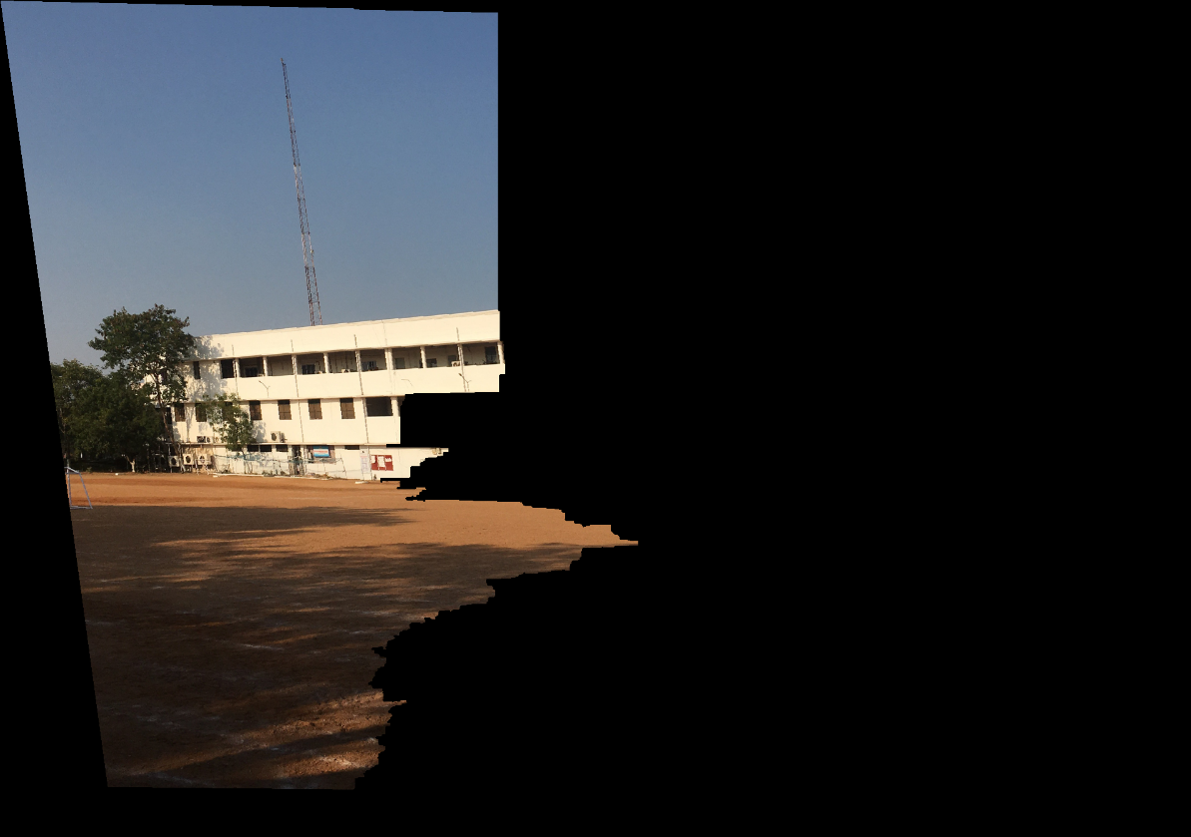
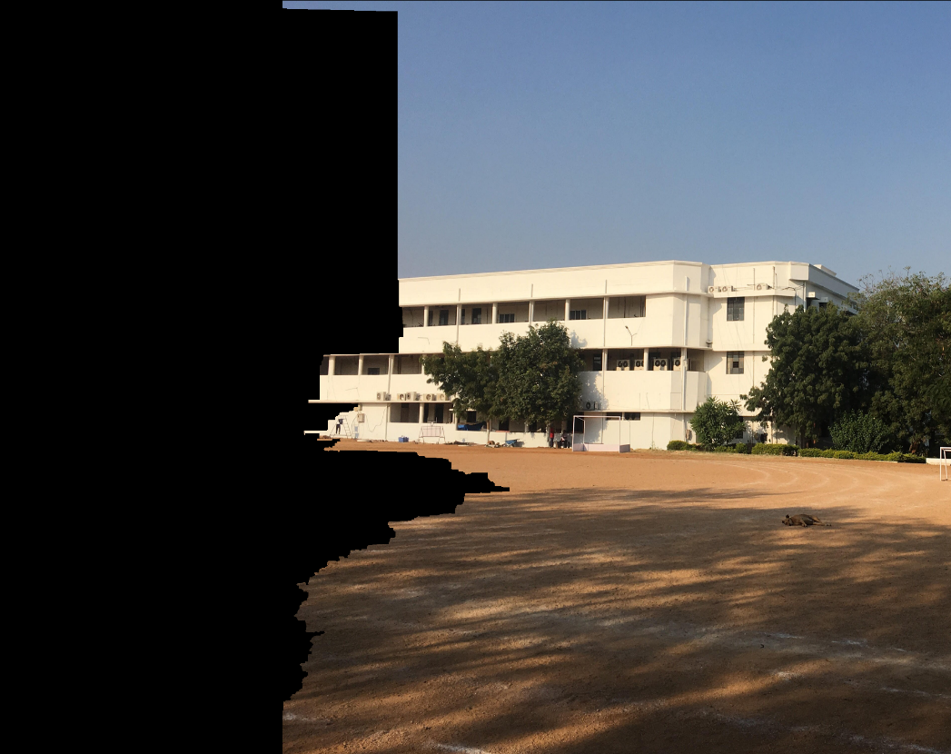
Result of seam finding

Slide 10
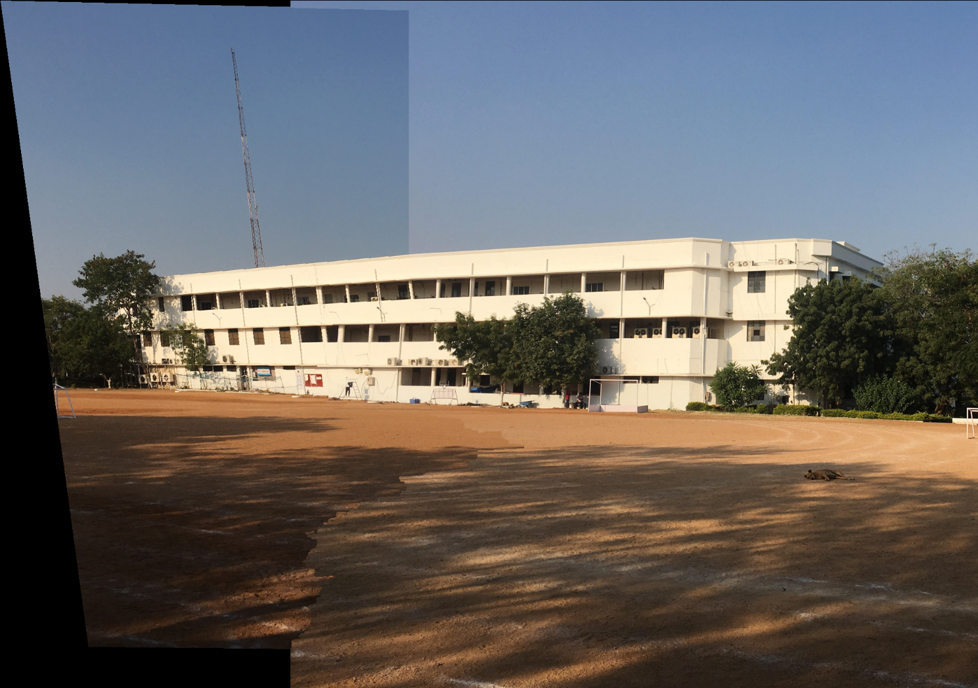
Blending

Slide 11
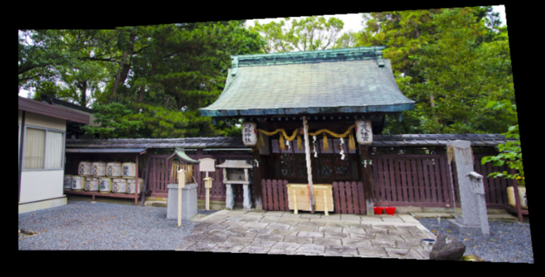
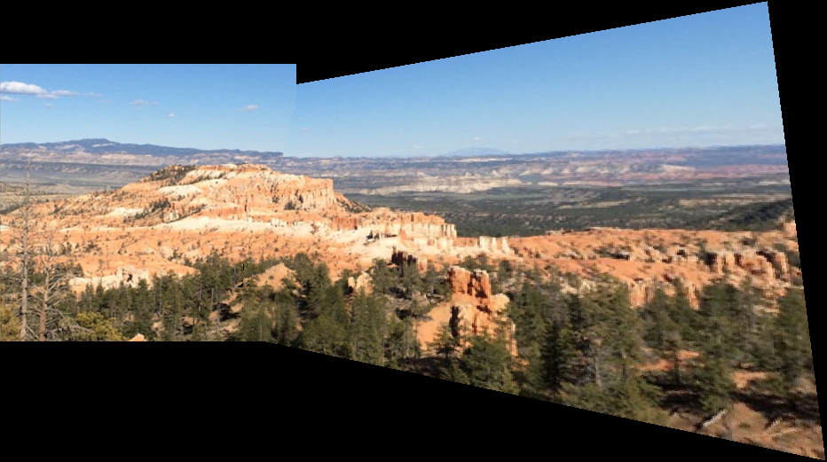
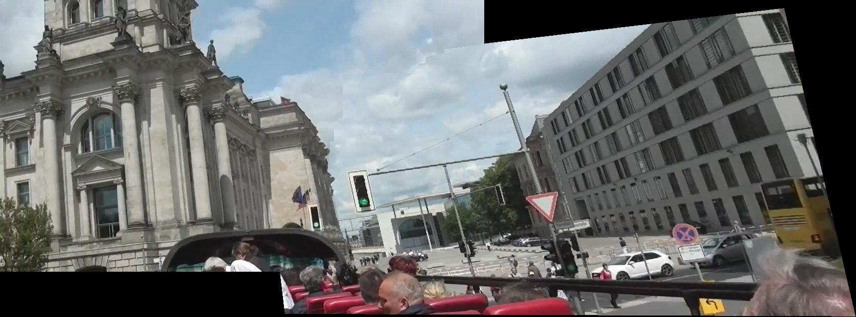
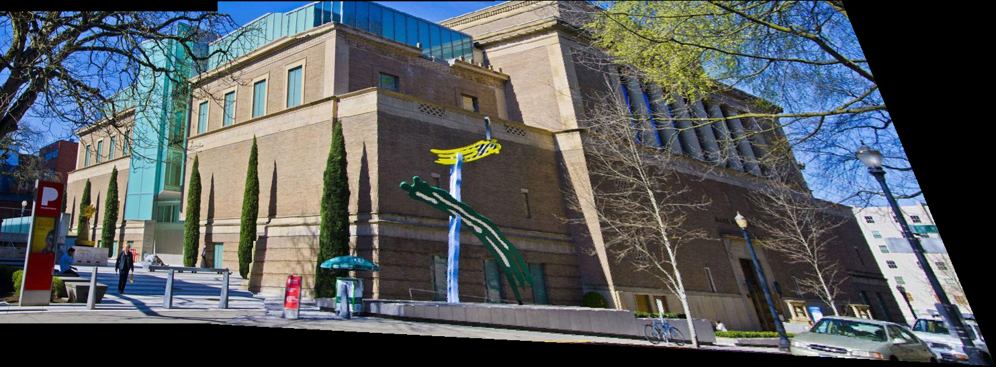
Some Results

Slide 12
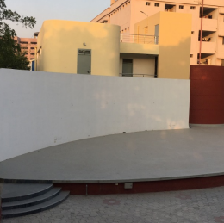
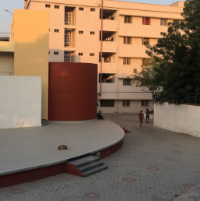
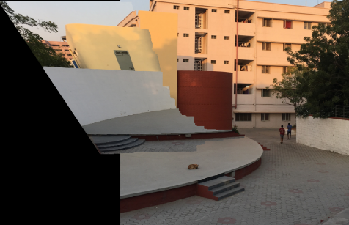
Failure

Slide 13
THANK YOU!

